Slide 1
PATIENTS DATA FOR HEART DISEASE PREDICTION
Disha and Caterina

Slide 2
ABOUT THE DATASET
PATIENT INFORMATION | Patient information, including demographic details like age, sex, and state, along with health-related factors such as general health, BMI, and medical history.
DIFFERENT CONDITIONS | It covers conditions like heart disease, stroke, diabetes, and asthma, as well as lifestyle choices like smoking, alcohol consumption, and vaccination status.
ROWS - 237630
VARIABLES - 35 COLUMNS
Notes:
Caterina

Slide 3
PATIENT CLASSIFICATION
SMOKING/ DRINKING HABITS
PATIENT PROFILE
BMI
MEDICAL RECORD
Notes:
Disha

Slide 4
WHY WE CHOOSE THIS DATASET?
01
02
03
04
Public Health Relevance
Predictive Potential
Heart disease is a major
global health issue, making this dataset impactful for addressing real-world problems.
Enables building a model to predict heart disease, contributing to early detection and prevention.
Personalized Medicine
Resource Optimization
Analyzing patient data helps in tailoring treatment plans based on individual risk profiles.
Predictive insights can help healthcare systems allocate resources more efficiently to high-risk patients.
Notes:
Disha (3 and 4) & Caterina (1 and 2)

Slide 5
EXPLORATORY DATA ANALYSIS
EDA was a crucial step in this project due to the significant imbalance in the dataset, with 224,429 observations labeled as “No Heart Attack” compared to only 13,201 observations labeled as “Had Heart Attack.” This imbalance posed challenges for building an accurate predictive model and required careful examination and handling to ensure meaningful results.
- Understanding Class Imbalance:
The dataset’s skewed distribution necessitated a detailed exploration of both the majority and minority classes. EDA allowed us to identify potential biases in the data and assess how the imbalance might impact model performance, such as overfitting to the majority class.
- Identifying Key Features:
By visualizing relationships between features and the target variable (HadHeartAttack), we were able to pinpoint variables like HadAngina, AgeCategory, and DifficultyWalking as strong predictors. This step was crucial for focusing the modeling process on impactful variables.
Notes:
Disha
The dataset exhibits a significant imbalance, with 224,429 observations for "No Heart Attack" compared to only 13,201 for "Had Heart Attack." This imbalance can hinder the performance of predictive models, as they may become biased toward the majority class, leading to poor sensitivity for detecting heart attack cases.

Slide 6
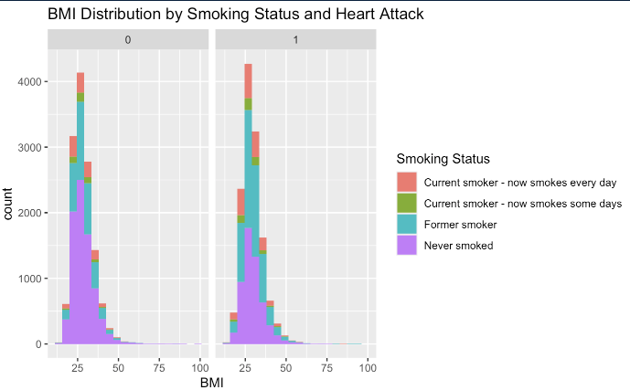
BMI by Smoking Status and Health Conditions
Notes:
Disha
When examining BMI by smoking status and health conditions, an interesting trend emerges: non-smokers who did not experience a heart attack far outnumber non-smokers who did. This suggests that non-smokers are more likely to fall into the "No Heart Attack" category, highlighting the protective effect of non-smoking against heart attacks.

Slide 7
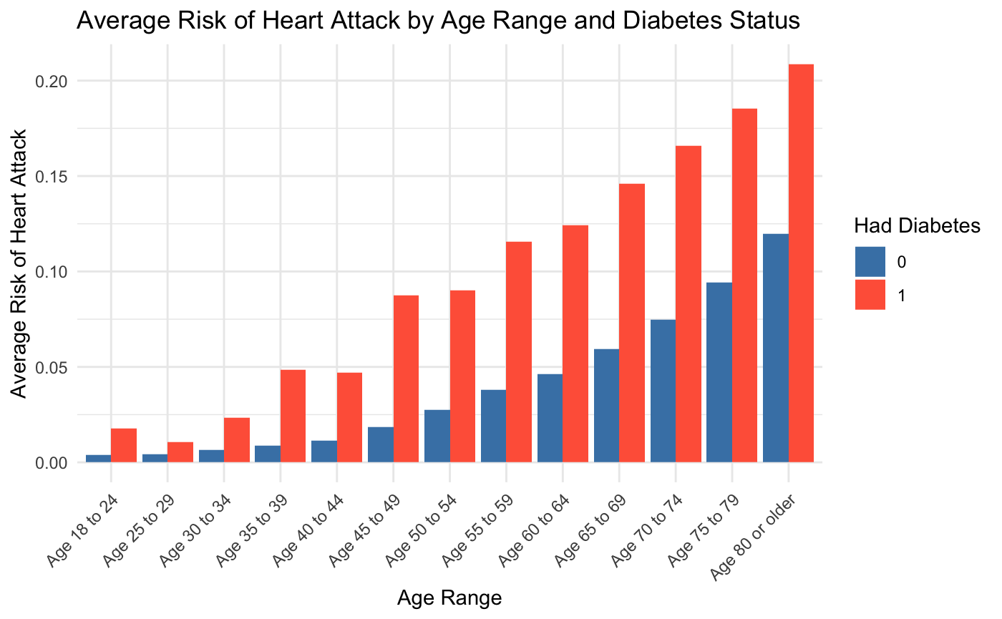
RISK OF HEART DISEASES IN RELATION TO DIABETES
Notes:
Disha Understanding Comorbidities: Diabetes and heart disease often coexist, and I wanted to delve into how diabetes impacts the likelihood of heart disease, particularly across different age groups. This is critical for identifying high-risk populations.
Higher Risk for Individuals with Diabetes: The graph shows a clear trend where individuals with diabetes exhibit a significantly higher average risk of heart disease compared to those without diabetes. This highlights the critical role of diabetes as a risk factor for cardiovascular issues.
2. Age-Related Increase in Risk: For both groups (diabetic and non-diabetic), the risk of heart disease increases with age. However, the increase is steeper and more pronounced among individuals with diabetes, particularly in older age groups.
3. Compounding Effect of Age and Diabetes: The combination of diabetes and advancing age exacerbates the risk, with the highest risk observed in older individuals who have diabetes.

Slide 8
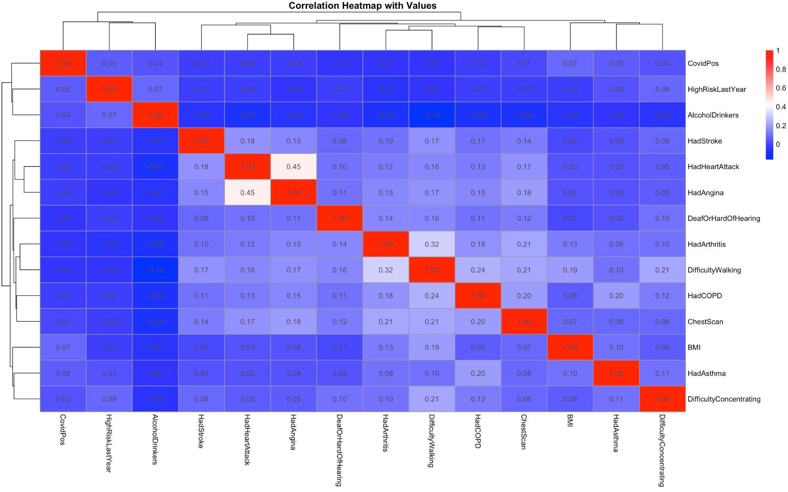
CORRELATIONS
Notes:
Caterina

Slide 9
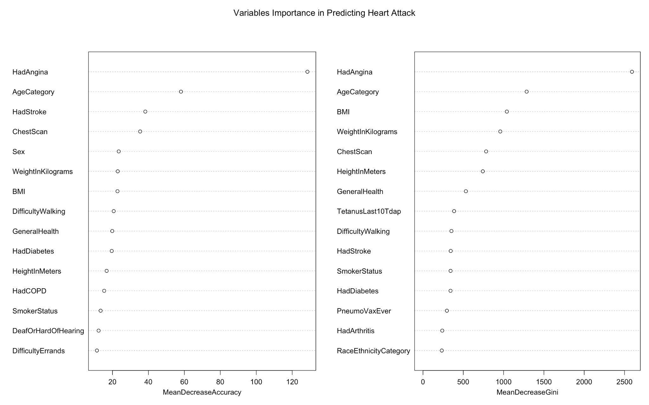
FEATURE IMPORTANCE
Notes:
Caterina

Slide 10
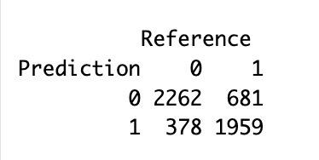
LOGISTIC REGRESSION MODEL
All Variables: Accuracy = 0.79
Top 5 Variables: Accuracy = 0.79 (no change)
With ‘HadAngina’ : Accuracy = 0.73
Without ‘HadAngina’: Accuracy = 0.75
Selected Variables [AgeCategory, ChestScan, HadStroke, HadDiabetes, GeneralHealth]:
Accuracy = 0.72
Notes:
Caterina
Insight: Removing ‘HadAngina’ improved accuracy (0.75 vs. 0.73).
Insight: Using only the most important variables did not change the model’s performance (0.79).
We tested the model with various combinations of features. Surprisingly, removing one key feature, ‘HadAngina,’ resulted in a boost in accuracy, while reducing the number of variables didn’t change performance.

Slide 11
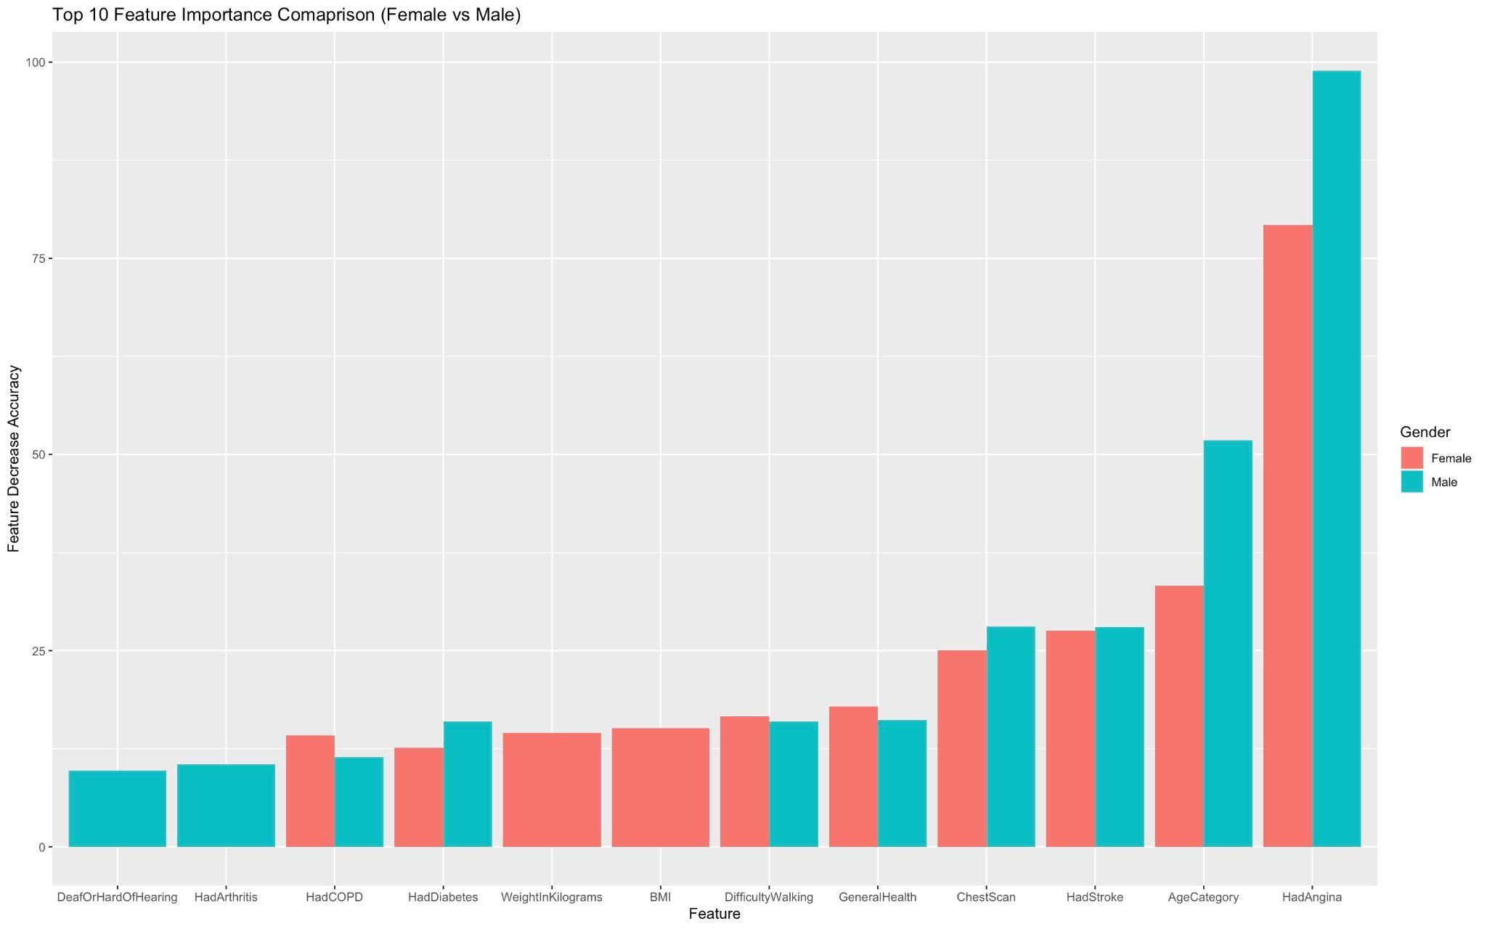
MALE AND FEMALE DIFFERENCES
Accuracy Female = 0.802
Accuracy Male = 0.795
Notes:
I split the dataset into male and female observations and fitted a logistic regression model for both groups to investigate gender differences in predicting heart disease. While there wasn’t a significant difference in model accuracy between the male and female models, the variable importance rankings revealed key distinctions.
For the male dataset, variables like deaf/hard of hearing and arthritis were among the most important predictors, whereas for the female dataset, weight in kilograms and BMI emerged as top predictors.
These differences highlight the importance of considering gender-specific factors when identifying variables that predict heart disease. A variable that is crucial for predicting heart disease in one gender may not hold the same importance for the other, underscoring the need for tailored approaches in modeling and intervention strategies.

Slide 12
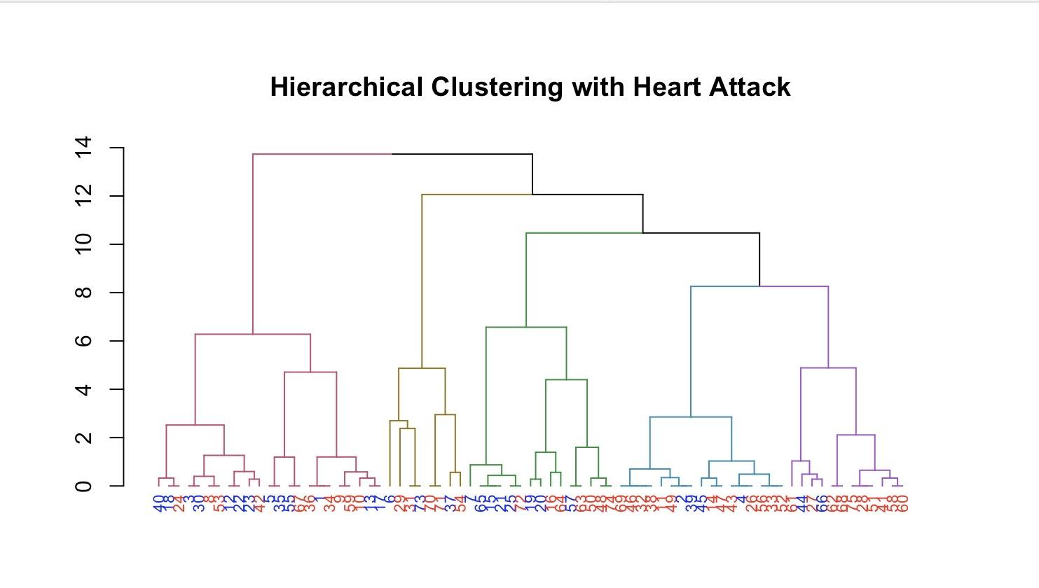
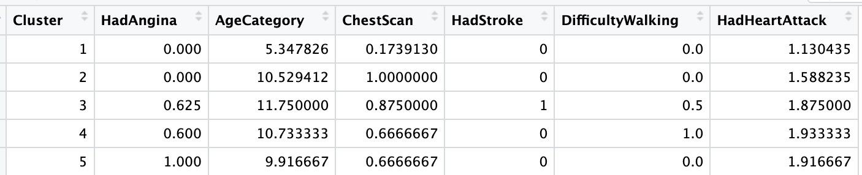
HIERARCHICAL CLUSTERING
Notes:
Caterina
A dendrogram is a diagram that shows the hierarchical relationship between objects.

Slide 13
CONCLUSIONS
1. Significant Predictors of Heart Attacks:
Random Forest Regression identified key variables contributing to heart attack risk. Among these, HadAngina and AgeCategory were the most significant predictors, highlighting their critical role in assessing cardiovascular risk. Other features, such as ChestScan and DifficultyWalking, also showed meaningful contributions.
2. Impact of Feature Selection on Model Performance:
The removal of HadAngina from the model led to a slight improvement in accuracy, suggesting potential redundancies or correlations with other predictors. However, the remaining variables still contributed significantly to the model’s predictive performance.
Notes:
Caterina (2) and Disha (1)

Slide 14
CONCLUSIONS
3. Clustering Insights:
Hierarchical clustering provided additional layers of understanding. Cluster 4, characterized by individuals with the highest proportion of heart attack cases, revealed specific patterns:
A high prevalence of individuals who underwent a Chest Scan.
Most individuals in this cluster did not have a stroke but reported difficulty walking.
Key predictors for this cluster included HadAngina and AgeCategory, underscoring their importance in identifying high-risk groups.
Notes:
Caterina and Disha

Slide 15
CONCLUSIONS
4. Holistic View of Risk Factors:
The combination of machine learning techniques and clustering analysis provided a comprehensive view of heart attack risk factors. It not only validated known contributors such as angina and age but also uncovered nuanced insights like the role of mobility issues and diagnostic procedures.
5. Implications for Preventive Care:
These findings emphasize the importance of targeted interventions, particularly for individuals exhibiting the identified high-risk features. Routine monitoring, early detection of symptoms like angina, and addressing mobility limitations could significantly reduce heart attack risks.
Notes:
Disha (4 and 5)

Slide 16
THANK YOU

